Slide 1
Living Longer, Living Stronger:
Role of Therapeutics in Healthy Ageing
Phil Atherton, University of Nottingham
Proud member of CMAR!

Slide 2
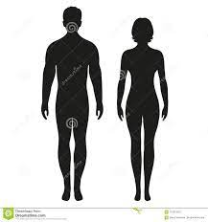
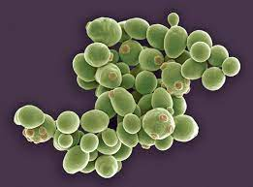
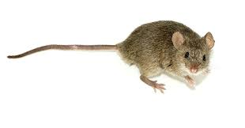
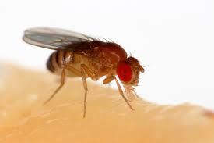
?
Can we modify the aging trajectory – experimentally speaking!

Slide 3
So – what “works?”
We can do one (or perhaps both) of two things.
Continue to treat individual diseases of ageing
Focus on common ageing biology to affect chronological ageing

Slide 4
Lifespan vs. health-span is somewhat a fallacy based on modern medicine: we treat disease to keep people alive – not to prevent disease. “We externally influence poor health-span and good lifespan”
Keeping things alive longer, in the lab at least, is associated with fewer health issues, hence less death. So: we need to delay onset of disease
Frailty is a compound issue and stands out from classical organ specific “disease” as there is no consensus on diagnosis ----- or treatment
There is no lab animal model of frailty representing human ageing!

Slide 5
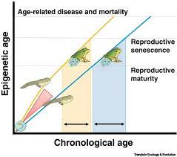
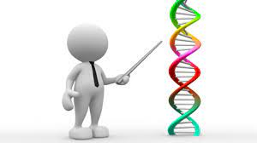
Is there a clock?
… Can you turn back the clock?

Slide 6
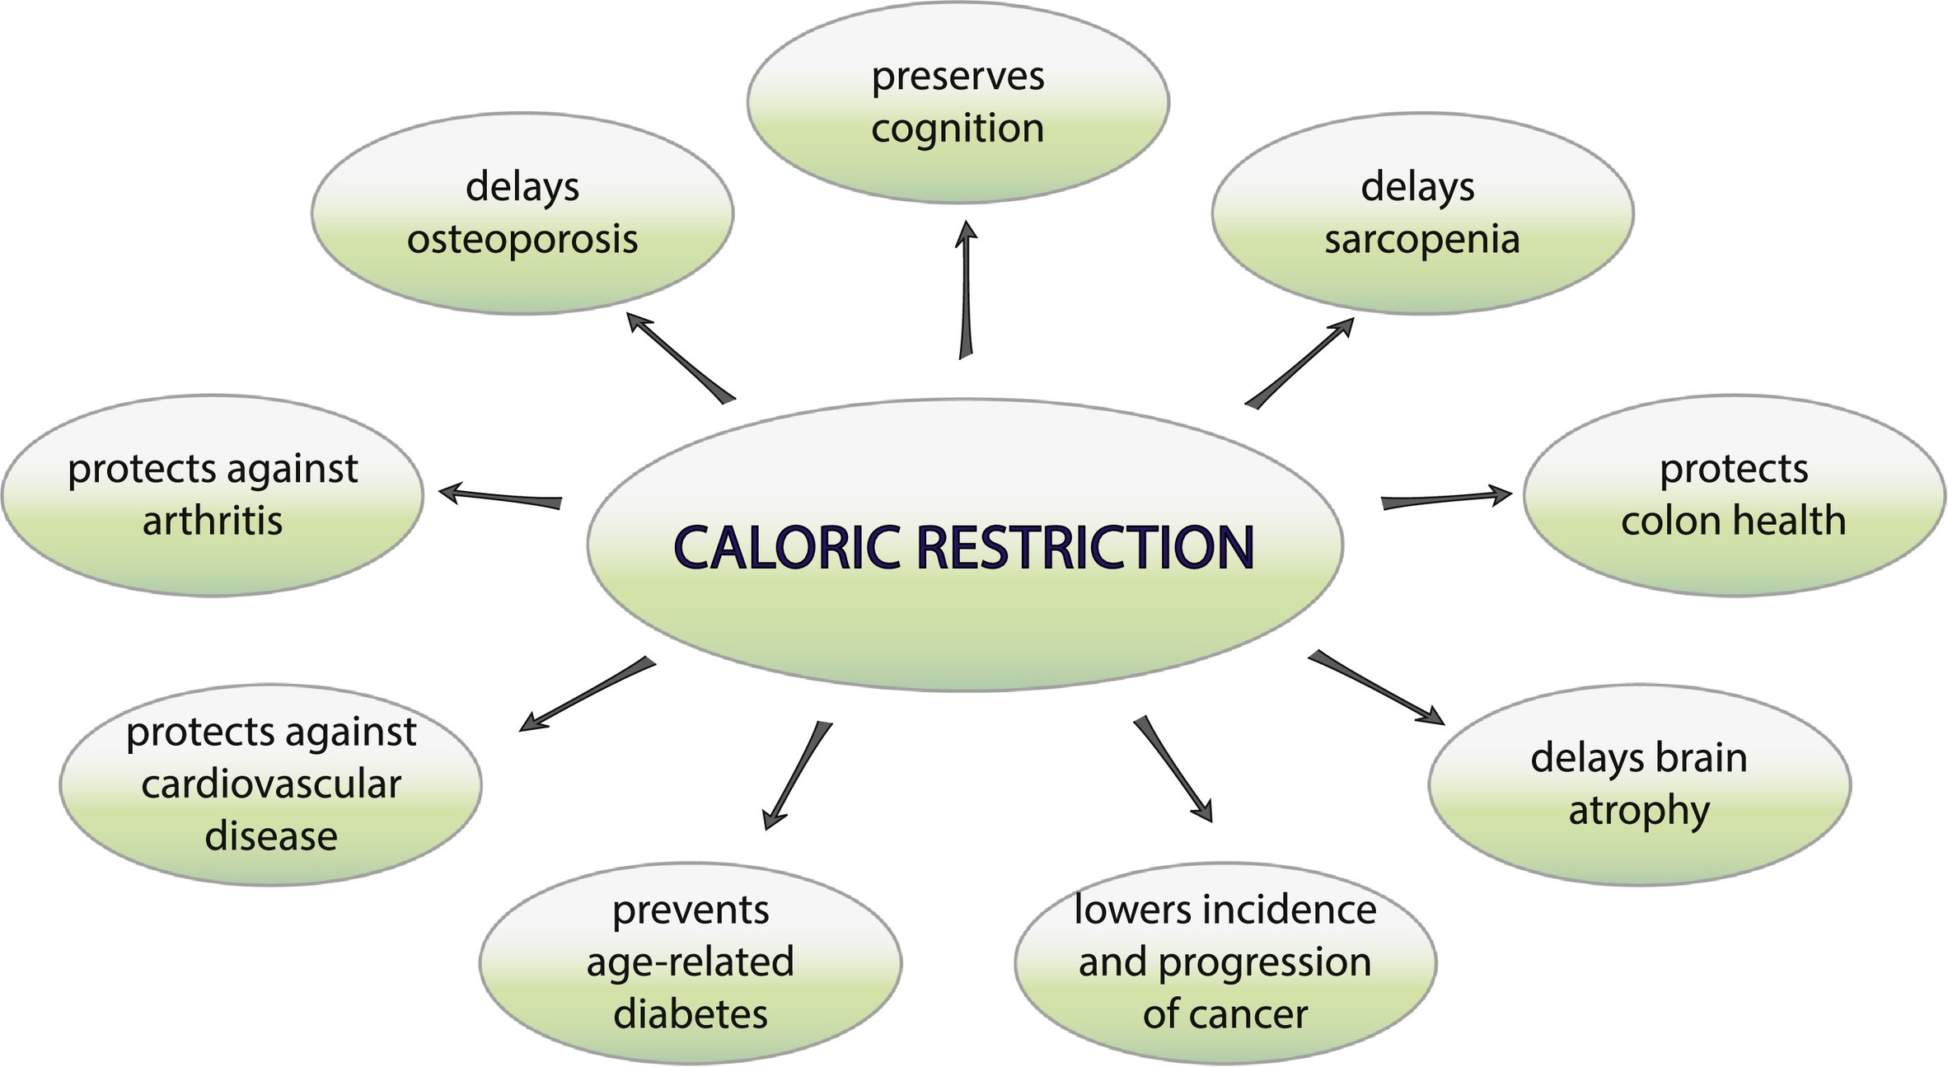
Calorie restriction!
Let me provide some examples…
Could you imagine trying to do this experiment in humans! Or even practicing this!
?
Ethics?
Effect on sarcopenia?
Quality-of-life!
How does it work???

Slide 7
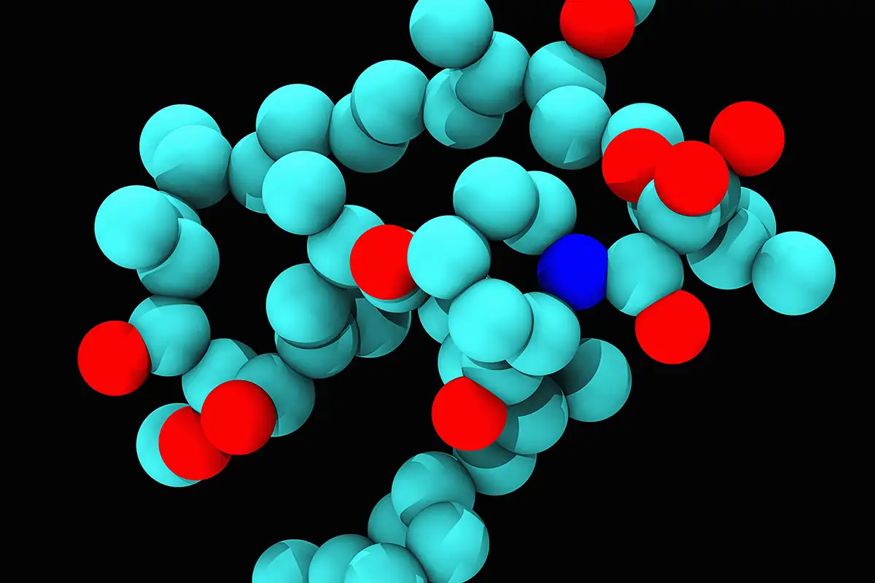
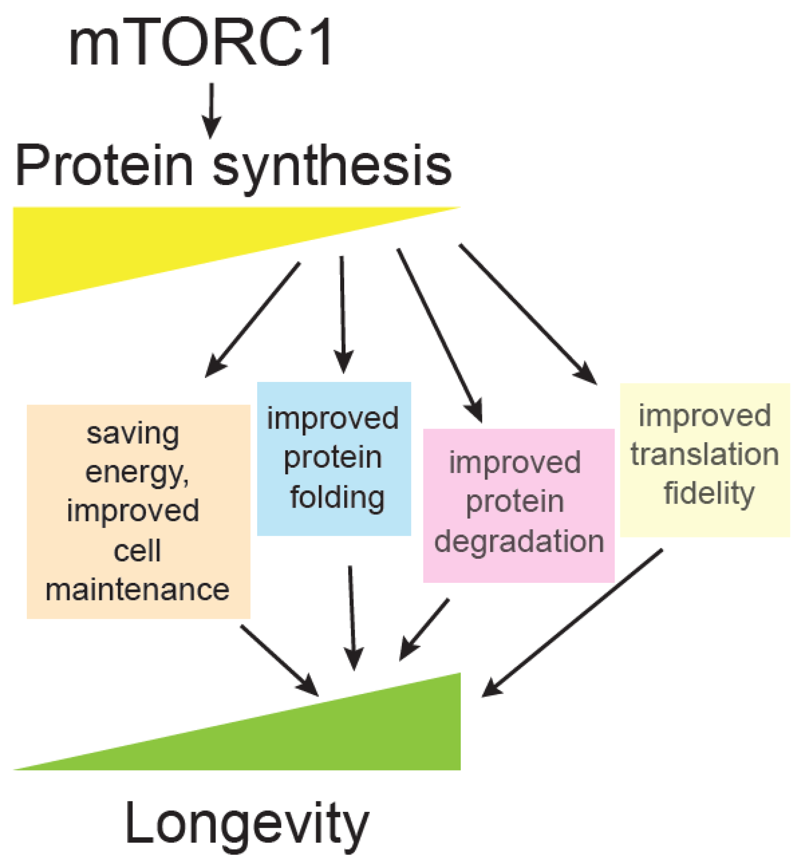
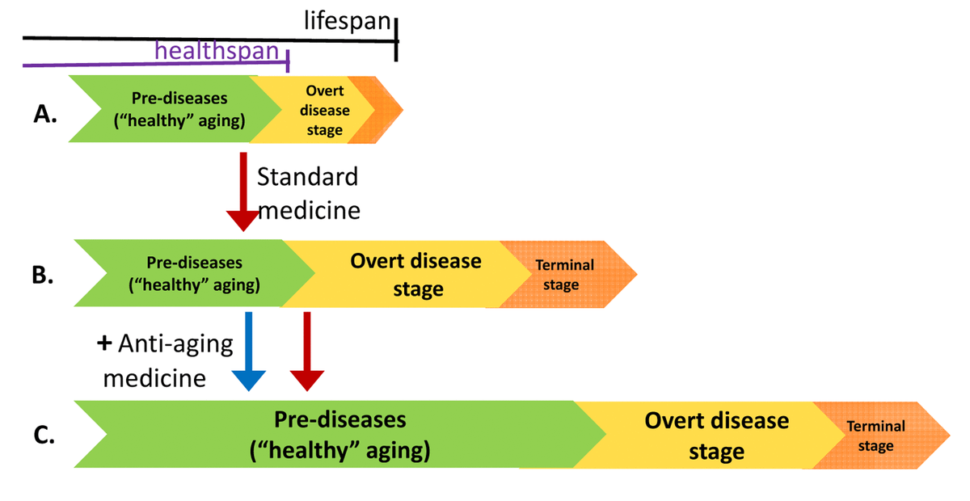
What about drugs/pharmaceuticals?
RAPAMYCIN

Slide 8
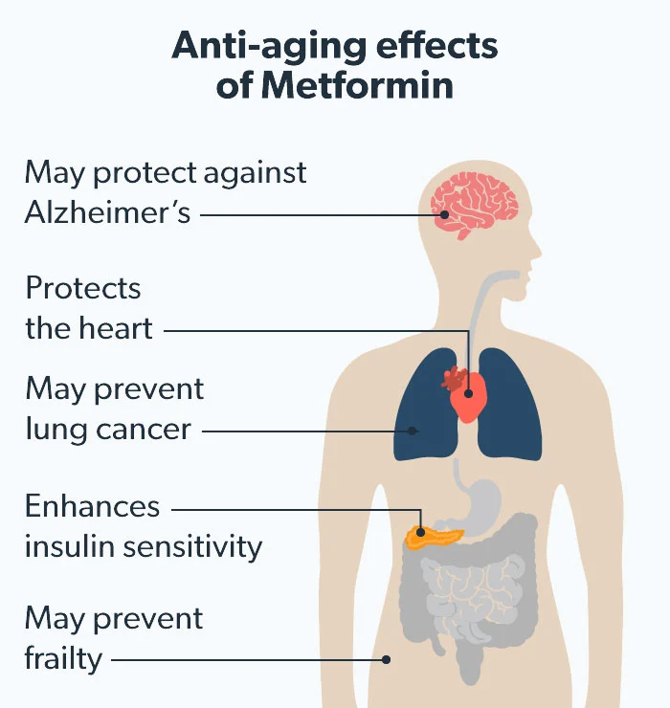
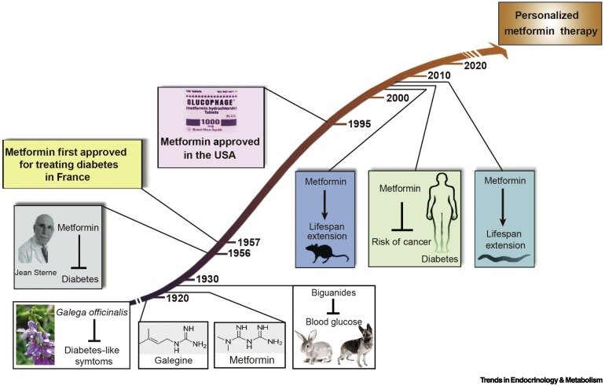
Say what???
A currently used Diabetes therapy may extend health/lifespan?

Slide 9
What else is on the horizon?
Anti-oxidants – to quell oxidative stress
Success chances low?
Senolytics – mopping up cells that have gone a bit awry
Chances low-medium?
Microbiome – and and gut nutrient handling
Chances low-medium?

Slide 10
Thanks!
Looking forward to the discussions!

