Slide 1


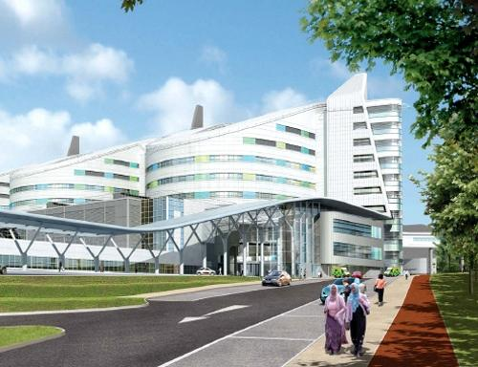
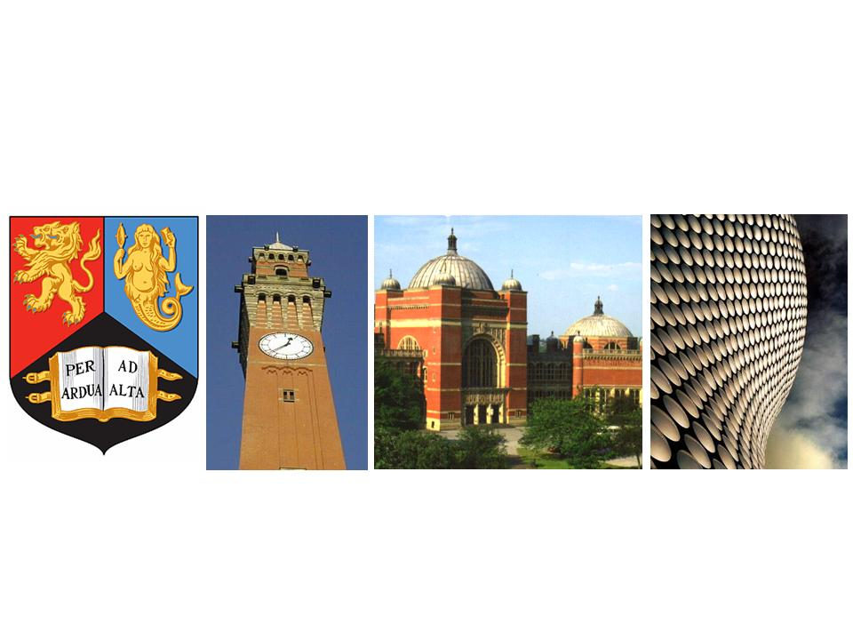
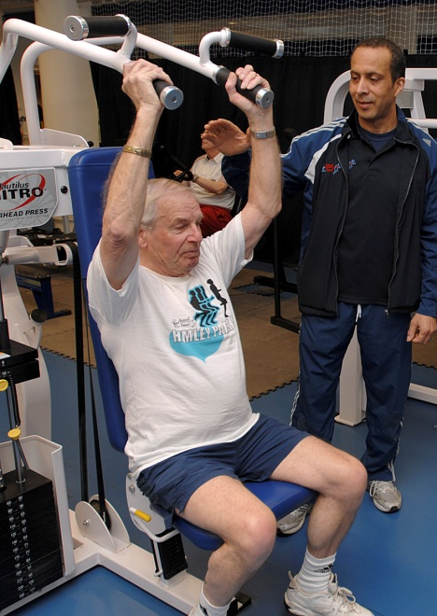
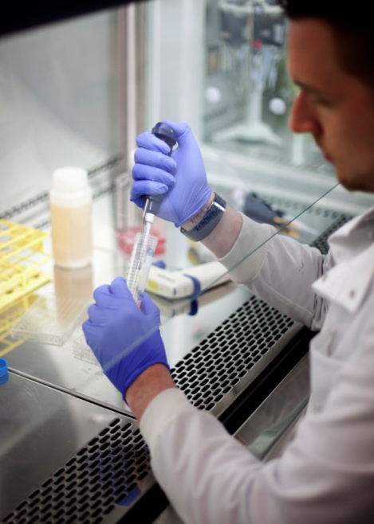


MRC-Versus Arthritis Centre for Musculoskeletal Ageing Research: 2012-2023
Director: Professor Janet Lord CBE
Deputy director: Professor Paul Greenhaff

Slide 2
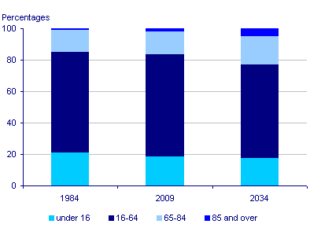
We are an Ageing Population
MRC-Versus Arthritis Centre for Musculoskeletal Ageing Research
Between 1984-2009:
Number of individuals in UK aged ≥65 years increased by 1.7 million
Number of individuals aged ≥85 years more than doubled to 1.4 million
By 2034:
23% of population ≥65 years
5% of population ≥85 years

Slide 3
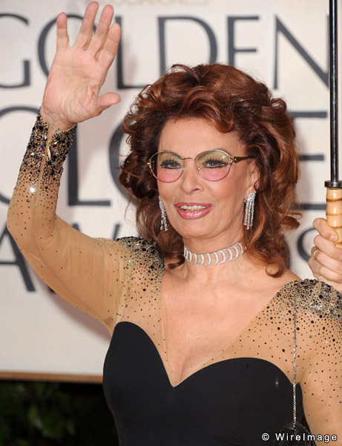
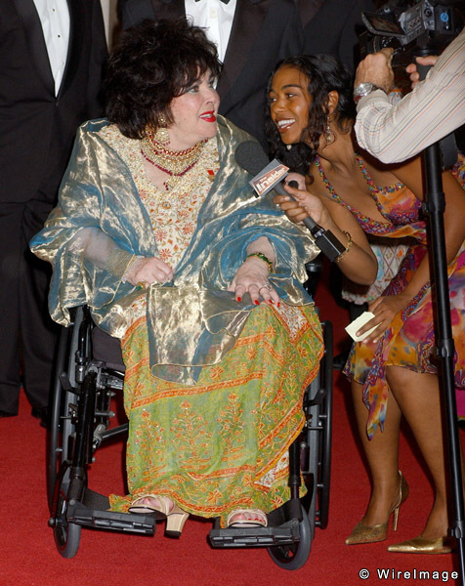
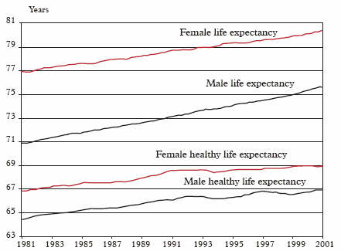
MRC-Versus Arthritis Centre for Musculoskeletal Ageing Research
We are not all Ageing Well

Slide 4
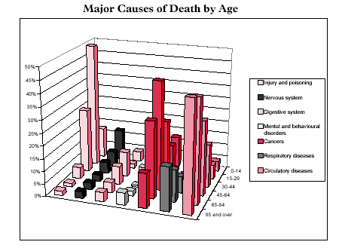
MRC-Versus Arhtritis Centre for Musculoskeletal Ageing Research
Unsuccessful Musculoskeletal Ageing is expensive and common
Falls: 1 in 3 adults aged over 65 fall each year;
Physical frailty and inactivity: Only 17% of men and 13% of women aged 65-74 are physically active enough. Cost £8.2bn (excludes £2.5bn for obesity);
Osteoporosis: 3m affected in UK, results in 300,000 fractures, cost £1.7 billion;
Arthritis: >6m patients, 1% of gross national product;
Incontinence: 1 in 4 older adults affected ; 2% of NHS budget, £1.4 bn..

Slide 5
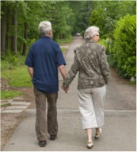

MRC-Versus Arthritis Centre for Musculoskeletal Ageing Research
Centre Mission: Understanding Musculoskeletal Ageing in order to frailty and disease

Slide 6
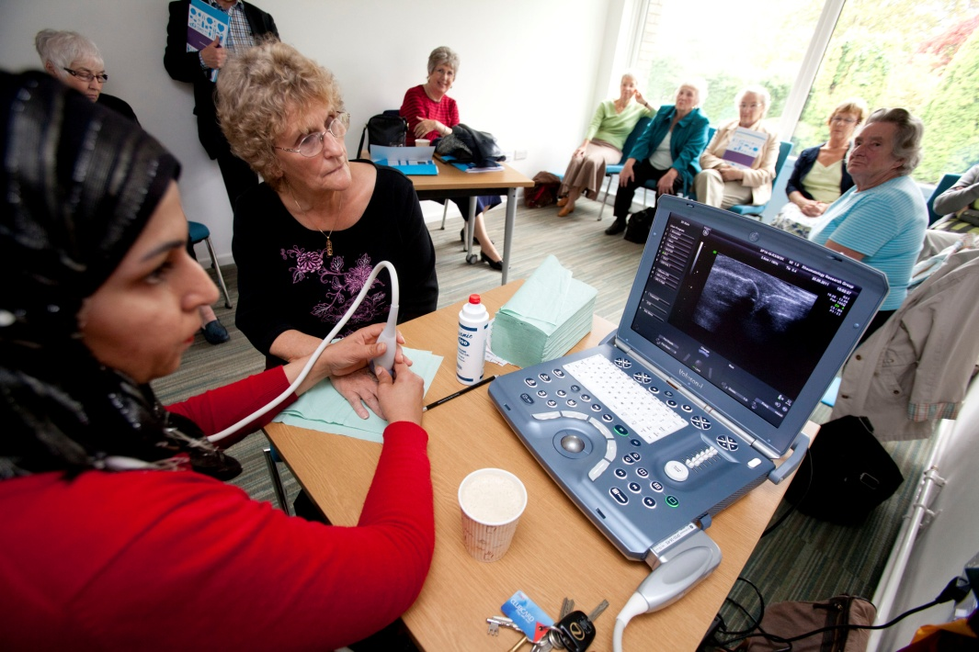
MRC-Versus Arthritis Centre for Musculoskeletal Ageing Research
Centre Vision: An inclusive attitude to optimising Musculoskeletal Health
Ultrasound image
Keeping the Healthy well as long as we can, but.....

Slide 7
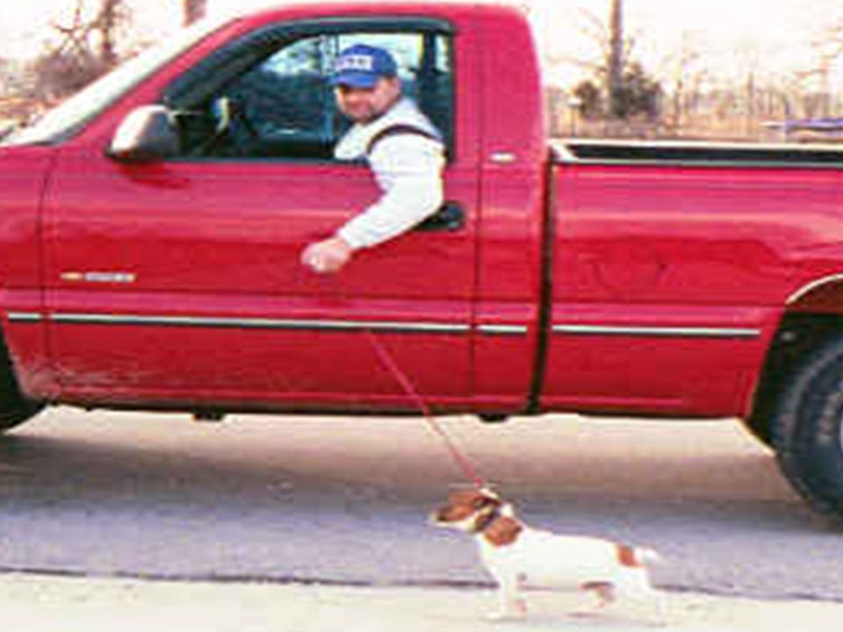
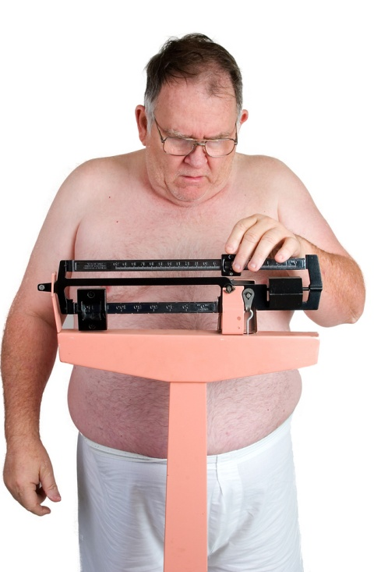

MRC-Versus Arthritis Centre for Musculoskeletal Ageing Research
Centre Vision: An inclusive attitude to optimising Musculoskeletal Health
Obese image
Helping with those with a relaxed attitude to ageing....

Slide 8
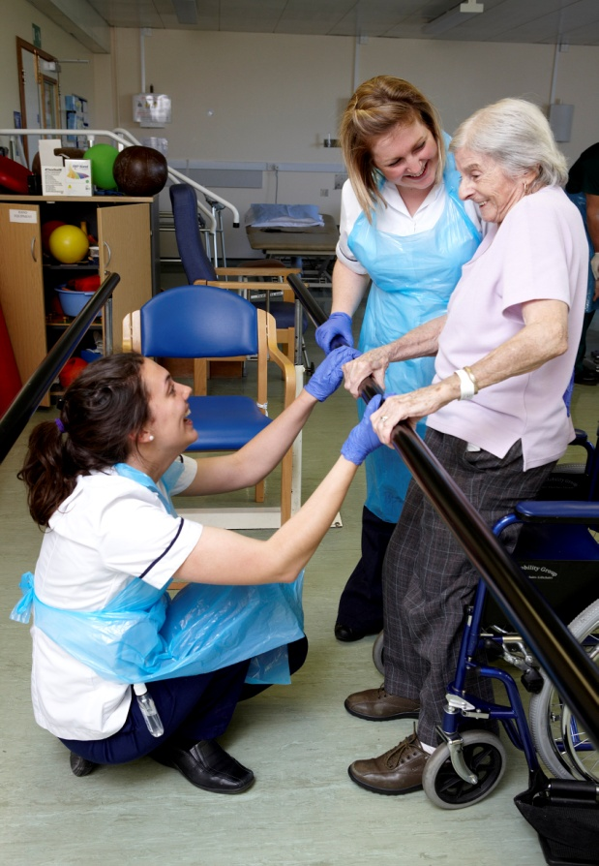
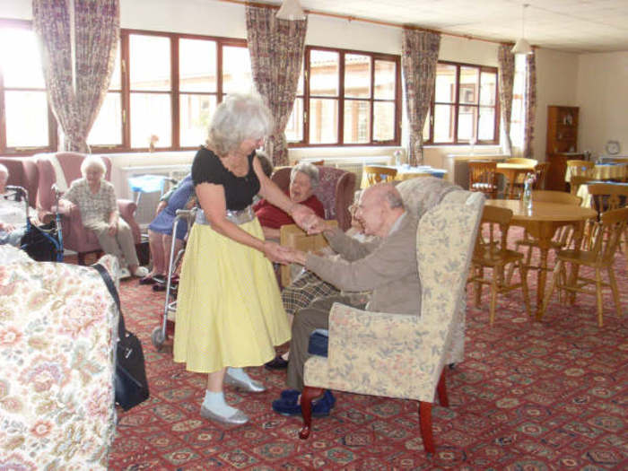
MRC-Versus Arthritis Centre for Musculoskeletal Ageing Research
Centre Vision: An inclusive attitude to optimising Musculoskeletal Health
Care home
Plus those for whom maintaining good health has to be achieved in varied settings....
Frail image image

Slide 9
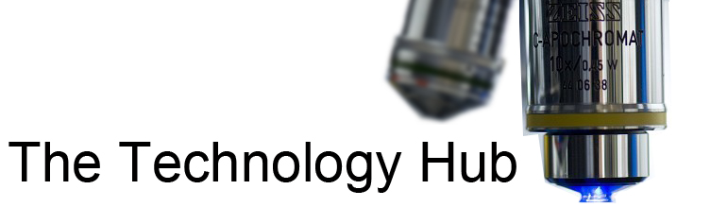
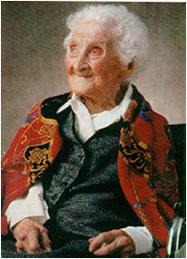
MRC –Versus Arthritis Centre for Musculoskeletal Ageing Research
A focussed and strategic approach to a complex process

Slide 10
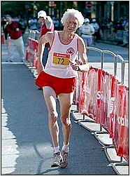
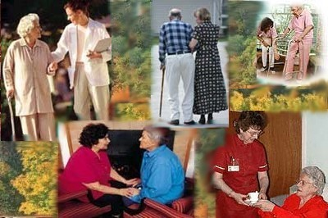
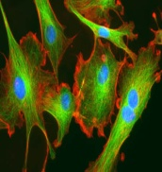
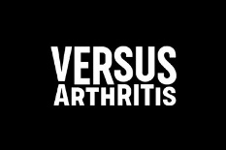

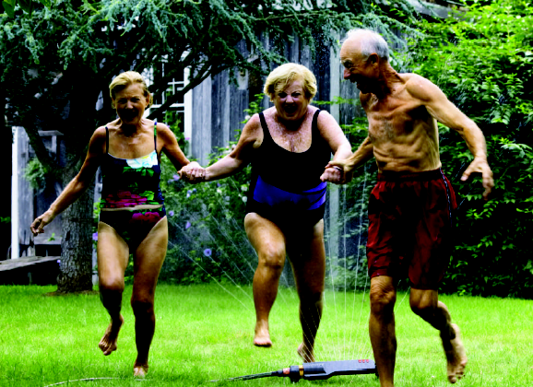
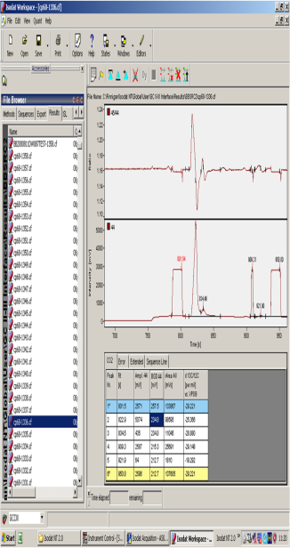
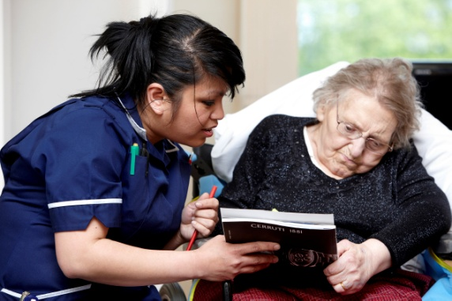
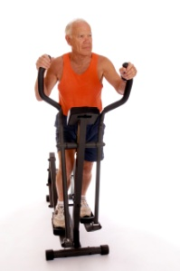
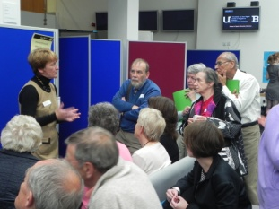
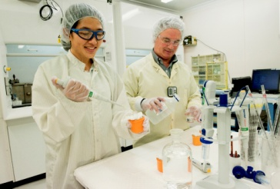
MRC-Versus Arthritis Centre for Musculoskeletal Ageing Research
What have we achieved?
££££
Increased funding, Improved leverage
Publications in basic and applied ageing research
Supporting lifestyle change in different settings
Influencing health + research policy
Evidence base for interventions
Consolidated industry links
Increased research capacity and methods
Public engagement

Slide 11
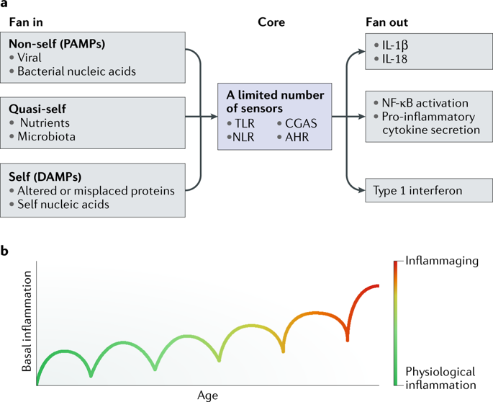
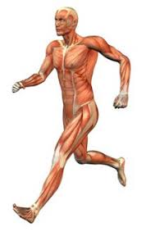
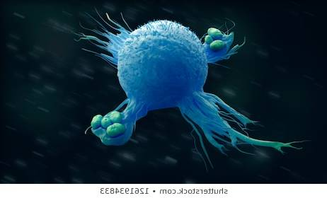
Skeletal Muscle – A key immune regulator
Muscle releases Myokines
Macrophages
↑IL10
↑IL-RA
↓TNF
IL6, IL7, IL15, MNRTL
Notes:
Skeletal muscle when active produces a range of hormones that enhance the immune system, making macrophages less inflammatory, increasing the killing ability of Nk cells that kill virus infected cells and also reducing the macrophage numbers in fat tissue. All this will protect against covid19 or if infected help to reduce symptoms.
Exercise will promote this activity. Several studies have shown that increasing physical activity reduces inflammation and improves immune function – 10000 steps a day improves neutrophil chemotaxis.

Slide 12
How little do I need to do?
*
*
<3k 5-7k >10k
Steps per day

Slide 13
MRC-Versus Arthritis Centre for Musculoskeletal Ageing Research
Ensuring Adults are Fit for Old Age

