Slide 1
Stronger for Longer: The Benefits of Weight/Resistance Training in Older Adult
Dr. Felicity Williams
Assistant Professor
Honorary Consultant Physiotherapist

Slide 2
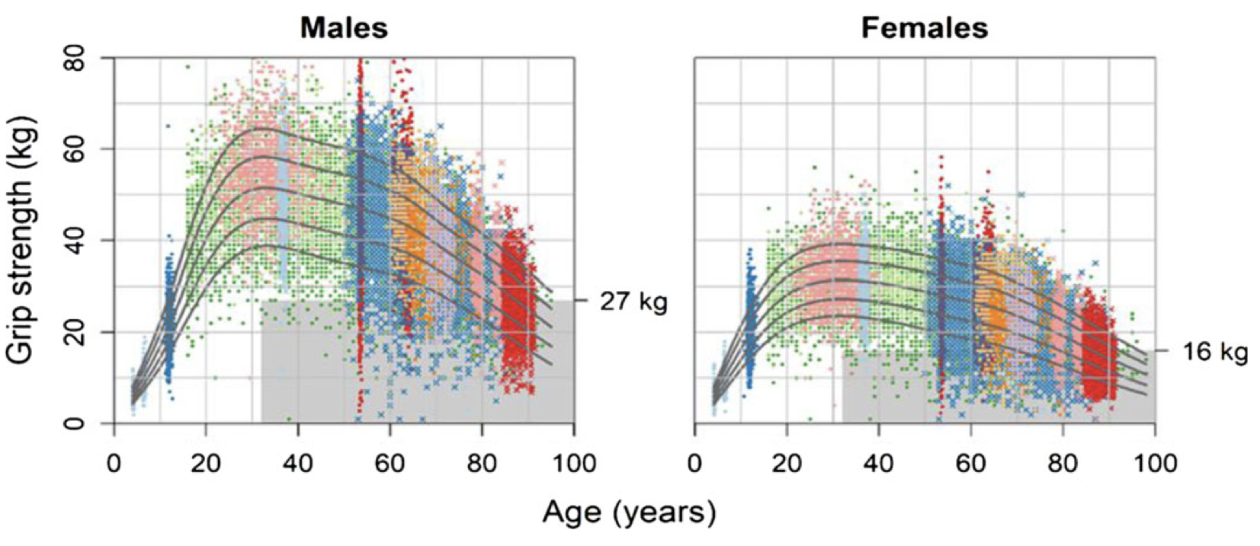
Strength declines with Age
Cruz-Jentoft et al. 2019
Notes:
Decline in leg strength with age, men on left women on right. The red line is the leg strength you need to get out of a chair unaided. The scans show loss of muscle with age and increased adiposity.

Slide 3
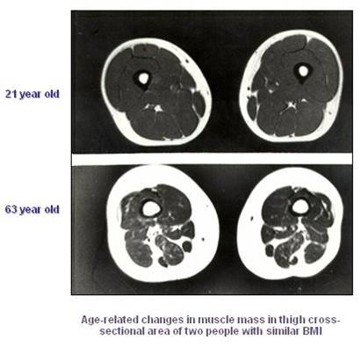
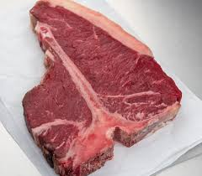
Loss of muscle mass and increased adiposity
1-1.5% muscle loss per year = 1-1.5 steaks per year!
Notes:
The scans show loss of muscle with age and increased adiposity.

Slide 4
Impact of age-related muscle loss
Loss of muscle mass
Loss of muscle strength
Decreased physical activity
Increased risk of falls
Dependency
Increased hospital admissions
Notes:
Only 41% of adults over the age of 75 are physically active – up from 31% in 2016 so need to continue in this directions

Slide 5
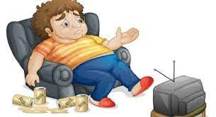
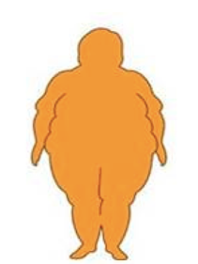
Notes:
Caused by a series of biological changes, loss of motor units, inflammation, poor nutrition, inactivity, disease, obesity

Slide 6
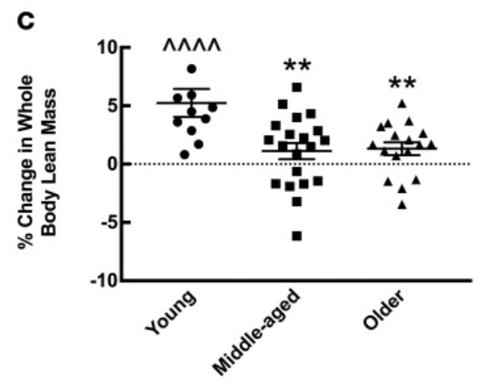
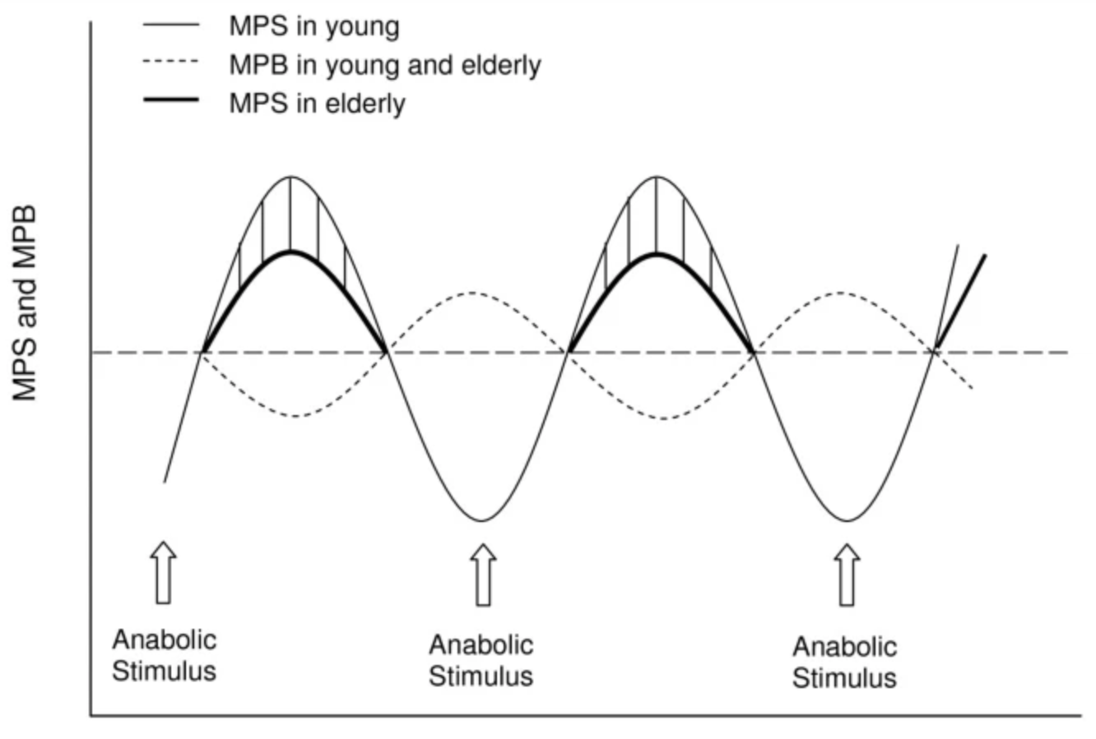
Maintaining muscle mass and strength is harder as we age
Breen et al. 2011; Phillips et al. 2017
Notes:
It was thought and is now known that people of older age are less responsive to anabolic stimuli. I.e. if an individual of an older age participated in exercise or ingests protein such they will have less muscle growth than a younger individual. This is highlighted in the shaded area between the bold and non-bolded line.
This has been practically shown in a paper by Beth Phillips and colleagues in the graph on the right which shows data from a 20 week resistance exercise programme in adults of different ages. At the end of 20 weeks an increase in muscle mass was only seen in the young group. This is why the CMO recommendation for older adults is 4 sessions of resistance exercise but only 2 in young adults.

Slide 7
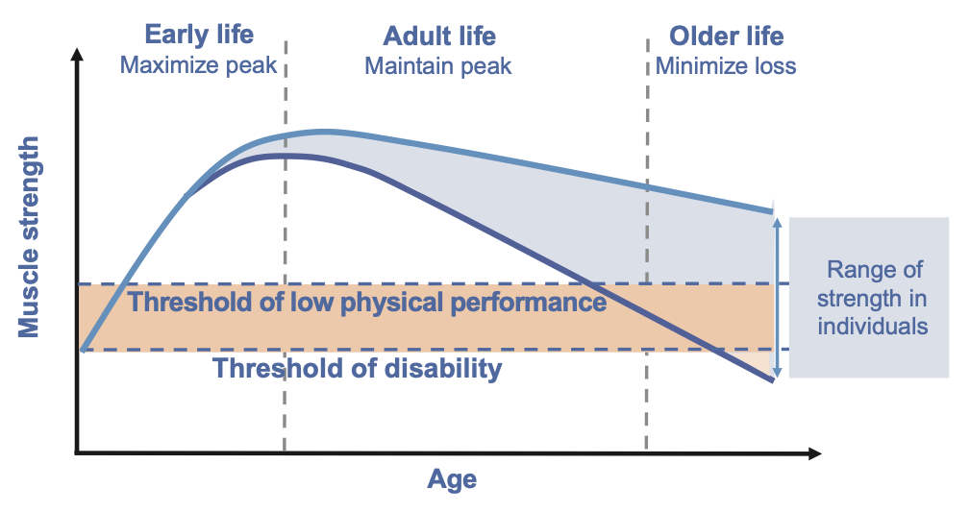
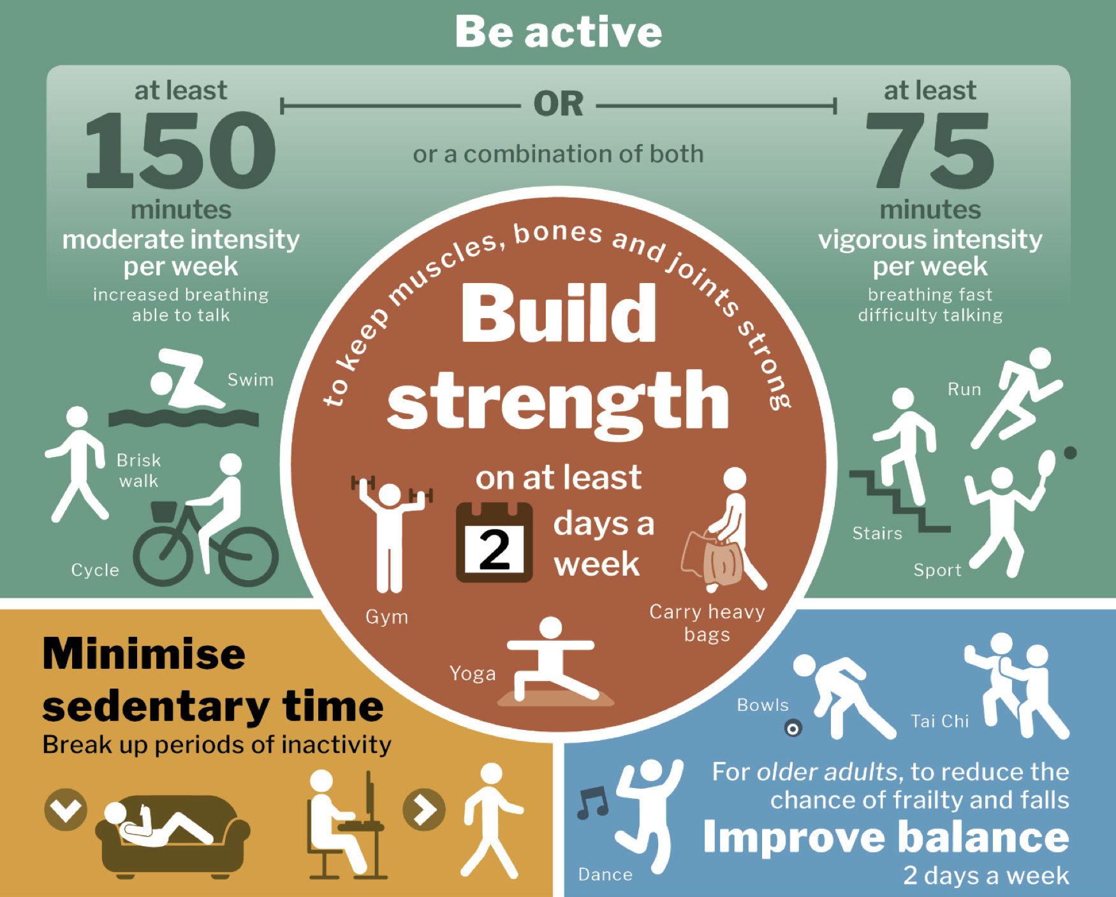
Investing in the muscle pension
Cruz-Jentoff et al. 2019; DoH 2019
Notes:
So, we know muscle declines as we age, and it is harder to build muscle when we are older. I am sure everyone’s aim is to maintain physical independence and for that reason, investment in the muscle pension early is advantageous. As you can see here, those who gain more muscle strength in early life and maintain it during adult life are more likely to maintain above the threshold for independence in older life.
However, it is never too late to start and combined with a nutritious diet the CMO advises people of older age should be participating in a minimum of 2 resistance/strength exercise sessions per week and I would say the evidence is now gravitating towards 2-4 sessions.

Slide 8
What is Resistance Exercise Training?
Using your muscles against a weight or force
Incorporated into an overall fitness program i.e. aerobic (walking), balance and flexibility
Involves a particular movement that is designed to strengthen a particular muscle or group of muscles
Reps, sets and rest
Progressive overload principle – challenging but with good technique
Recovery – alternating days

Slide 9
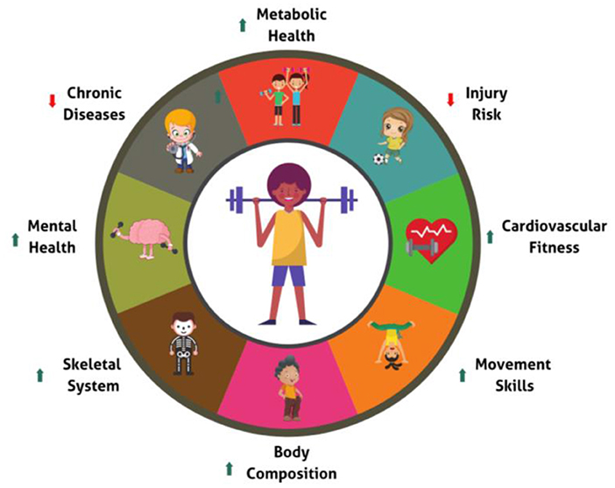
Why resistance exercise training?
Improves muscle growth
Bone density
Reduces falls
Reduces hospital admissions
Reduces mortality
(Ruiz et al. 2008)
Notes:
Over the age of 60 years, all-cause and cancer-associated mortality is twice as likely in individuals with low compared to high skeletal muscle strength

Slide 10
What does a resistance exercise program look like?
Programme | Recommendation
Repetitions (REPS) | 8-12 or 10-15
Sets | 1-3 sets per exercise
Intensity – how hard should I work? | 70-85% of 1RM or 2 REPS in reserve
Exercise selection | 8-10 different exercises – major muscle groups
Type of exercise | Machines, free-weights, resistance bands or bodyweight
Frequency | 2-3 days per week – alternate days!
Functional movements | Exercises to mimic tasks of daily living
Fragala et al. 2019

Slide 11
Benefits of resistance exercise…..

Slide 12
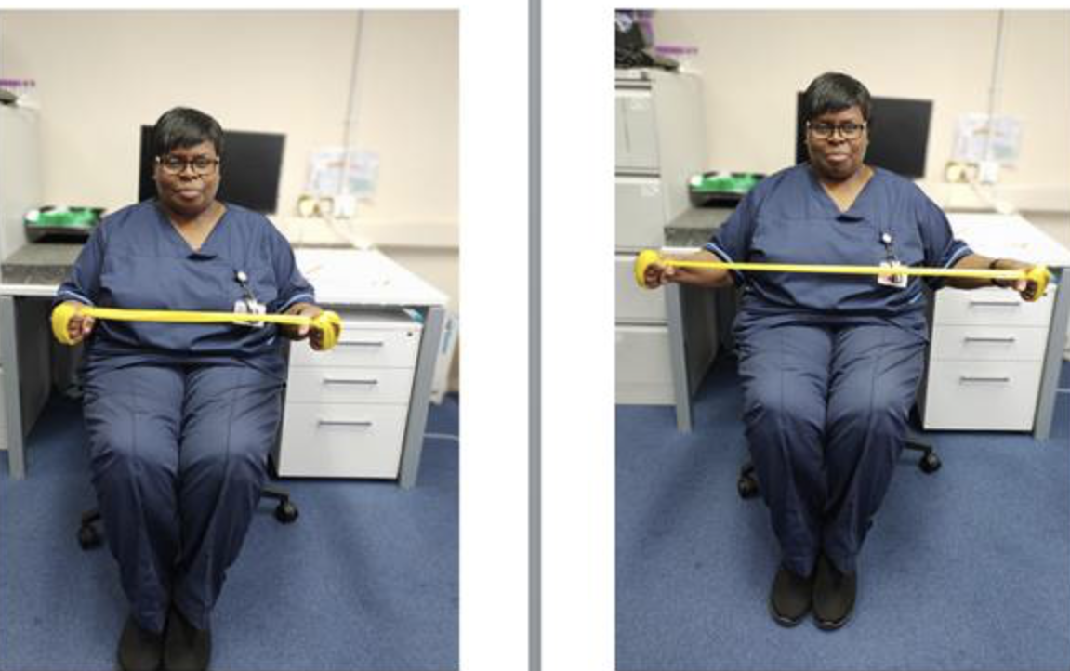
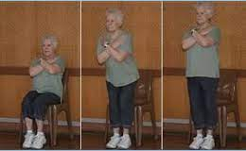
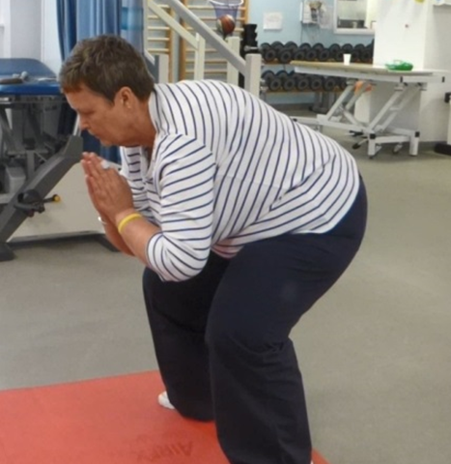
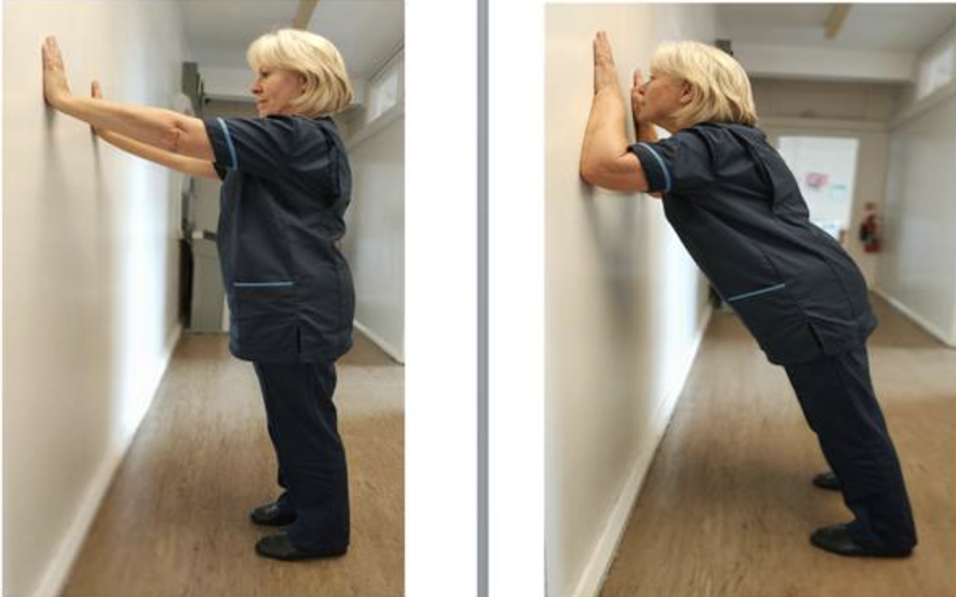
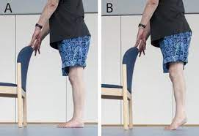
….but it doesn’t need to be complicated

Slide 13
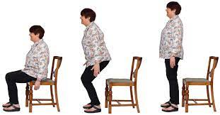
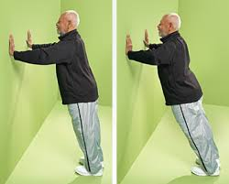
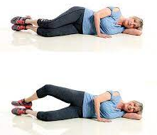
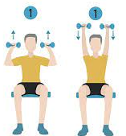
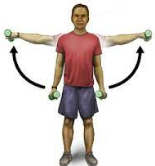
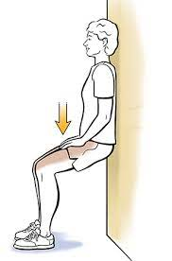
Example circuit
Chair stands
Calf raises
Shoulder press
Wall squats
Shoulder abduction
Lunges
Clams
Wall press
2 sets
8-10 reps
2mins rest between sets

Slide 14
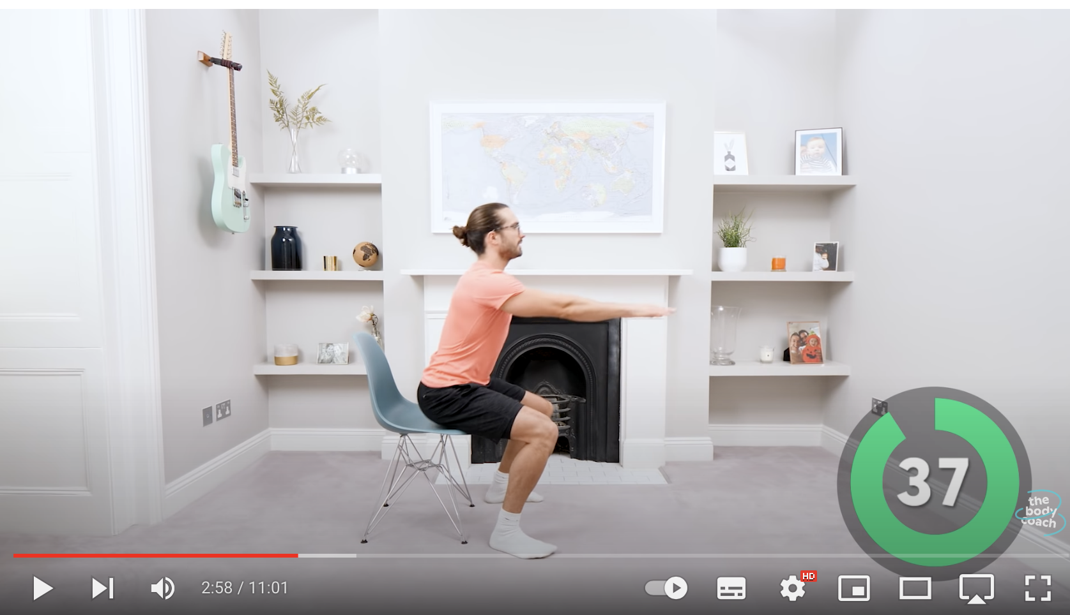
Where can I go to get support?

Slide 15
Take home messages
Muscle declines with age
More we do in our younger and middle-age years the more muscle in the pension pot
It is never too late to start
Resistance exercise 2-4 times per week gives you the best opportunity for muscle growth
Help is available – please contact your local activity teams

