Slide 1
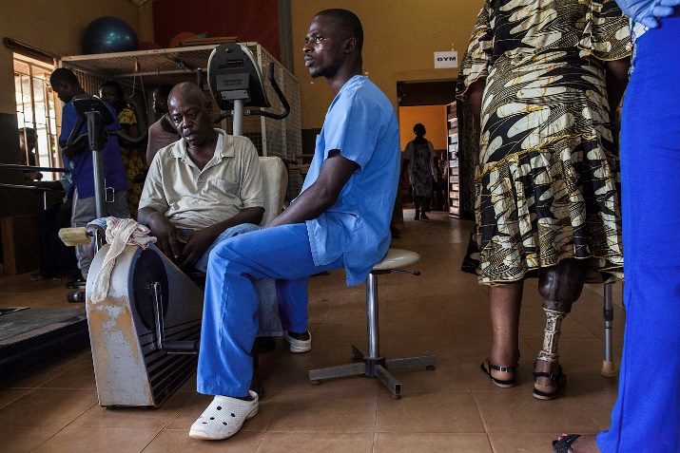
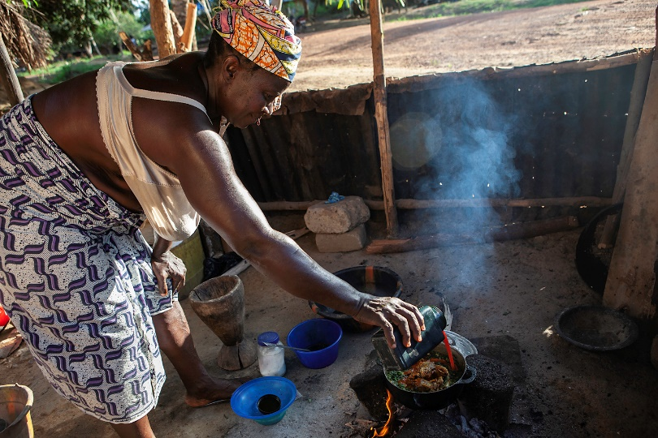
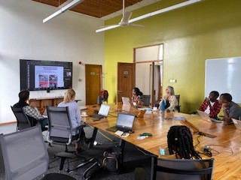
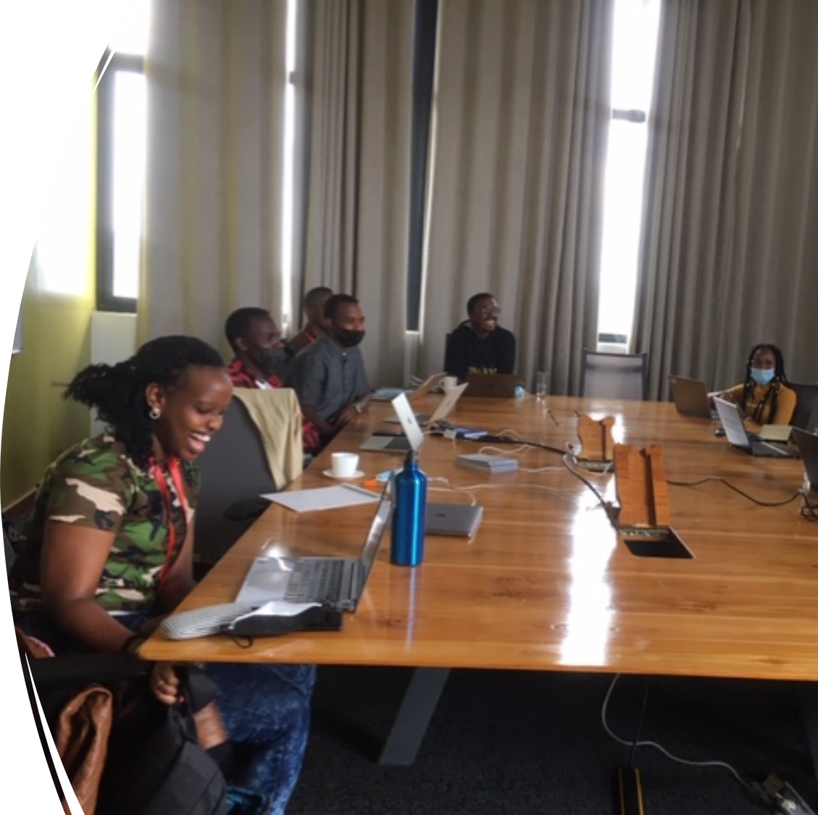
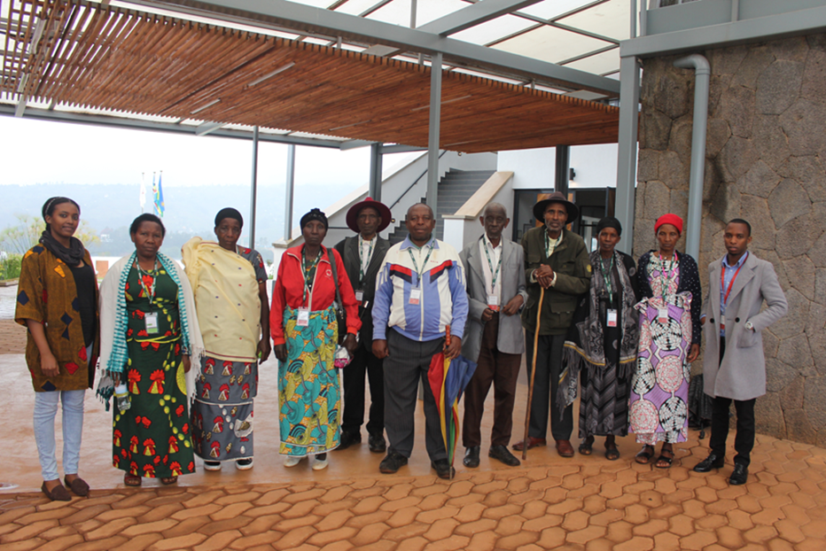
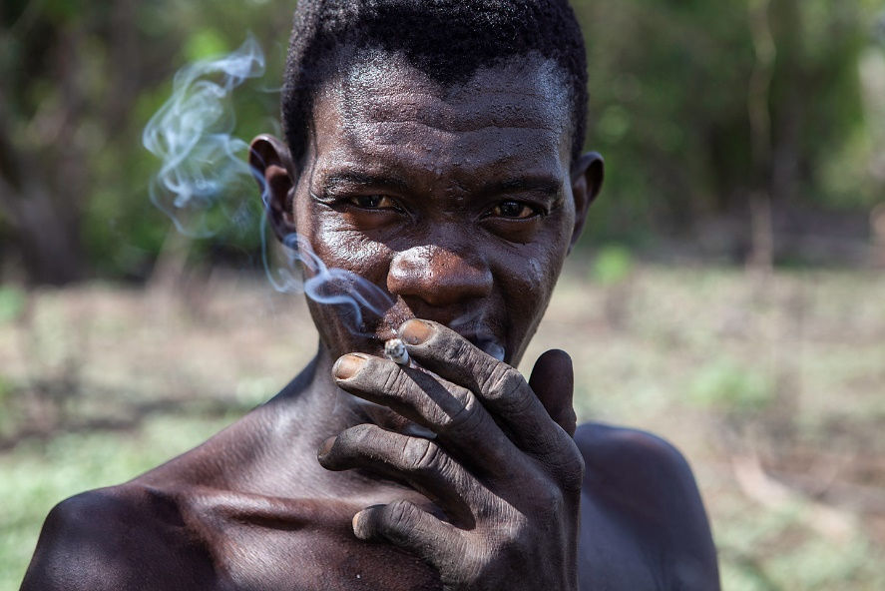
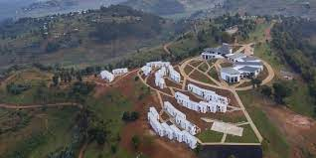
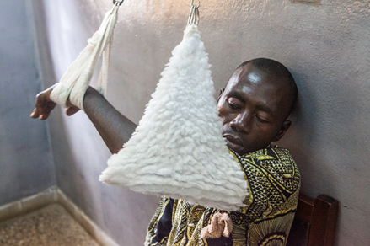
Healthy Ageing in LMICs

Slide 2
By 2050 >20% of people on the planet will be 60 years or older

Slide 3
What % of older people will live in LMICs by 2030?
20%
40%
60%
80%

Slide 4
Ageing in LMICs – a wicked problem!
Changes to policy and practice must be evidence based to efficiently deliver required health and social care services
75% of LMICs have no or limited data to inform healthy ageing
LMICs are not homogeneous: Research needs to be representative of the ageing populations in these countries to inform policy and practice

Slide 5
Ageing, Frailty and Resilience group
To partner with colleagues in the UK and in LMICs to develop collaborations, capacity build, collect data relevant to them, deliver research to inform policy relevant gaps in knowledge of ageing in LMICs, publish findings, and apply for research grants

Slide 6
Our work themes address key questions of relevance to older people living in LMICs
Ageing in society
What is important to older people and relevant stakeholders in LMICs?
Ageing and health
What health issues do older people suffer in LMICs?
What are the care needs of older people?
What is the quality of life of older people like?
How does frailty affect older people in LMICs?
Ageing and economics
What contributions do older people make to their economics (direct and indirect)?
What is the cost of ageing badly?

Slide 7
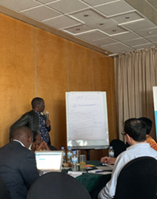
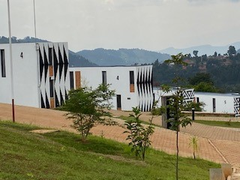
Identifying needs and priorities of older people and stakeholders in rural and urban areas of Rwanda, Pakistan and Brazil

Slide 8
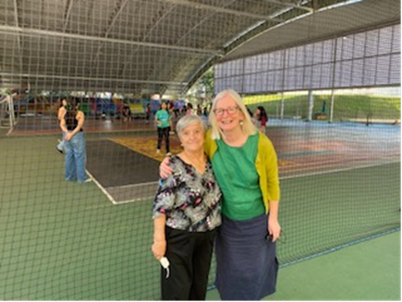
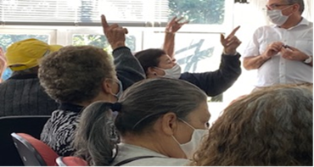
Ageing in society - workshops
Setting
Rwanda
Brazil
Pakistan
Rural and urban settings in each country
Participants
Older people and stakeholders who care for them
Questions
What is the local definition of ageing?
What are priorities for living a healthy and active life in older age?
What are barriers/ enablers to achieving those priorities?

Slide 9
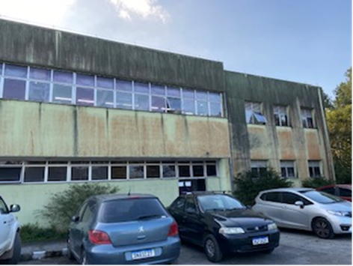
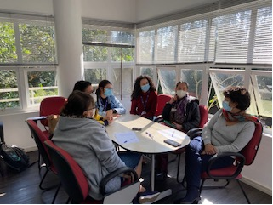
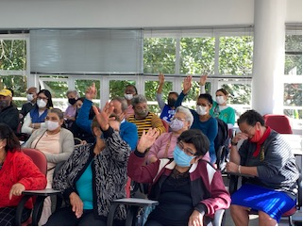
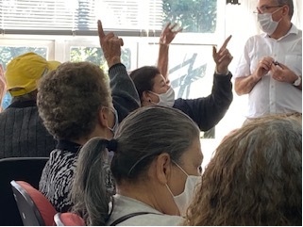
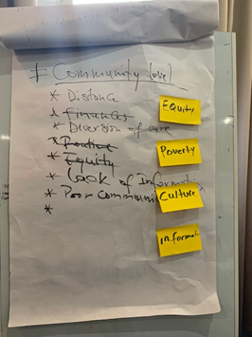
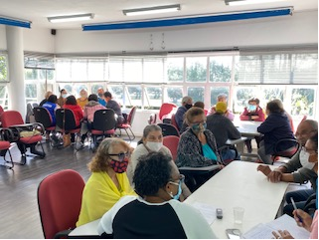
Older adults and stakeholders workshops in urban and rural areas of Sao Paulo state, Brazil

Slide 10
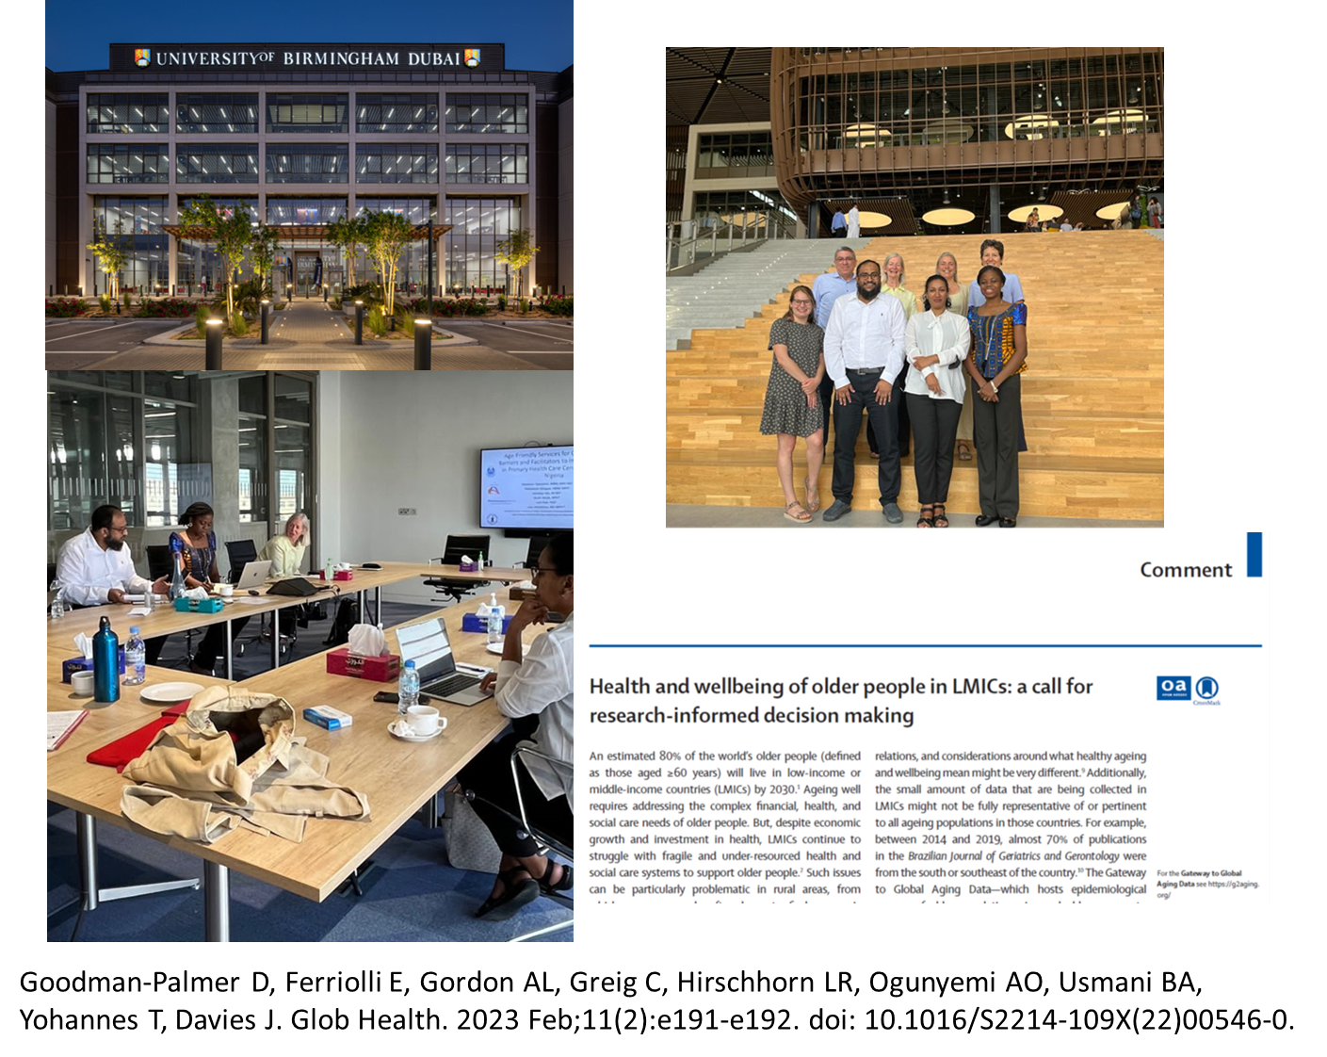
Ageing in society workshops: Next steps

Slide 11
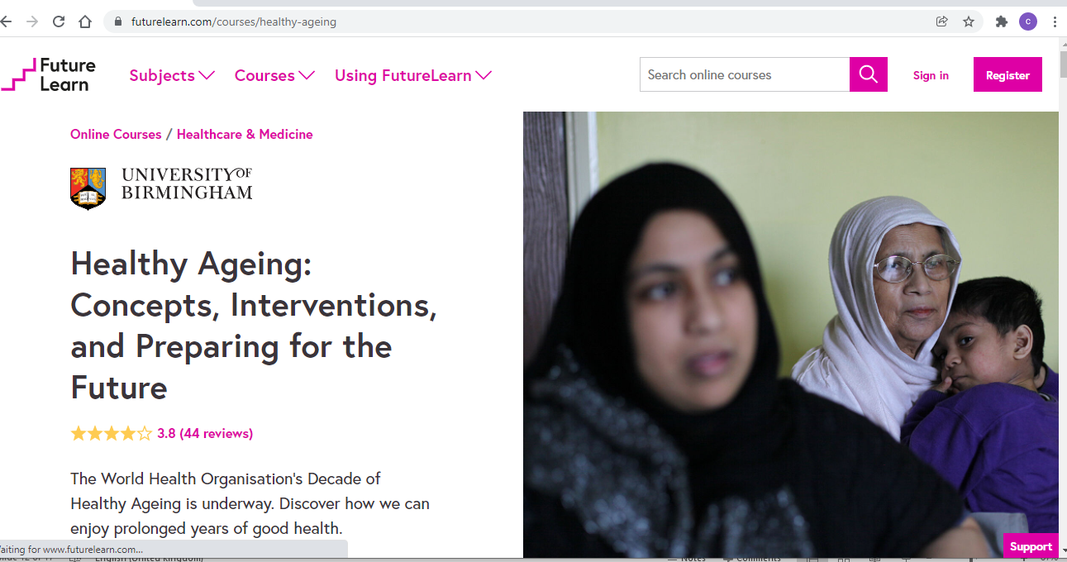
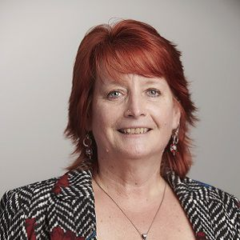
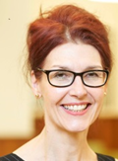
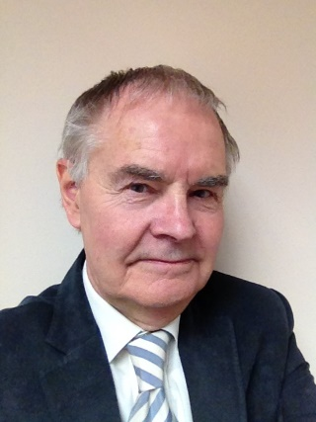
Healthy Ageing MOOC (massive open online course!)
Available on Futurelearn platform
Free to access
Global healthy ageing research: applications and insights
Muscle Health Public Involvement in Research Group
https://www.futurelearn.com/courses/healthy-ageing

Slide 12
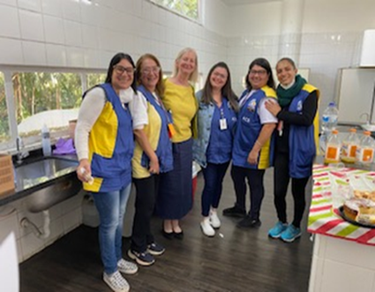
Thankyou

